Slide 1

iOS Dev Scout Singapore, October 2018

Slide 2

Thanh
Software Engineer
Rakuten Viki
linkedin.com/in/thanhturin/
thanhturin@gmail.com
Notes:
You can find more information about me by visit my home page on linkedin.
And if you have any question, please don’t hesitate to send a message to my gmail
For us here engineering, our mission is to bring the best experience to customers.
But because the resource we have is limited, hence whenever we want to implement anything, we always need to consider between the cost and the profit it can bring to us.
So today in my presentation, I would like to share with you one solution that doesn’t cost you too much effort
But can help your service reach out a lot of more users.
And the more users, the more profitable

Slide 3
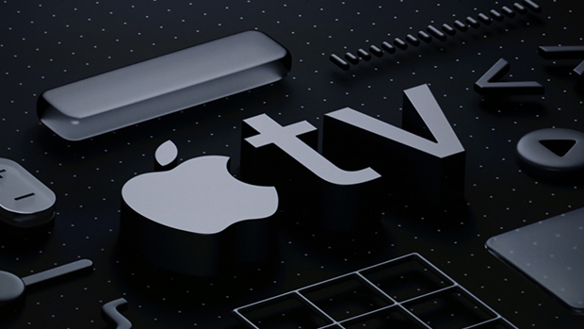
Developing For Apple TV
Notes:
And the topic I will bring to you is about “Developing for Apple TV”

Slide 4

Agenda
Overview of Apple TV and tvOS
Developing for Apple TV
Demo
Notes:
For the agenda today, I will break my talk into 3 separate sections
First, I will briefly introduce about Apple TV and tvOS
Then, I will give you some fundamental things when working with Apple TV
And finally, I will show you how thing works in reality with a real demo

Slide 5
Apple TV & tvOS
Notes:
So okay. Let’s quick start with Apple TV and tvOS overview

Slide 6
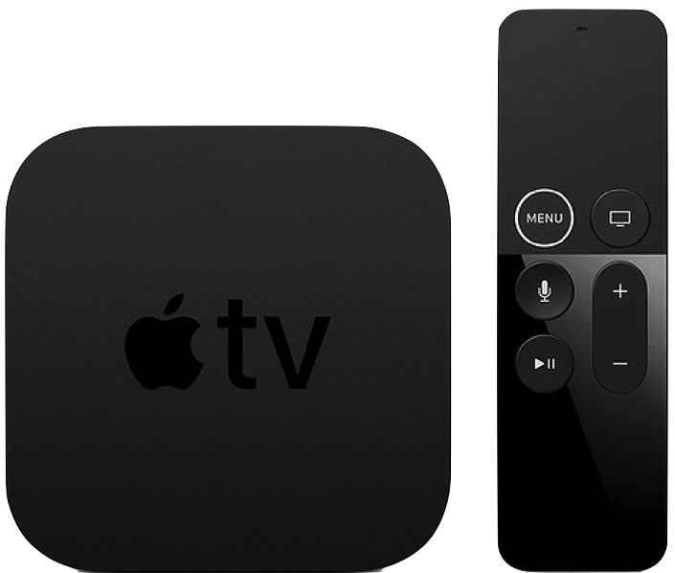
Apple TV 4K
5th Gen (2017)
Notes:
Apple TV is a digital media player device. It can collect data from internet.
And to use it for viewing, you have to connect it to a TV by a HDMI cable.
On the screen is the latest Apple TV, Apple TV 4K
Stand next to it is the Siri Remote, we will use it to control the Apple TV
Furthermore you also can use your iPhone to communicate with Apple TV.
This is something pretty awesome from Apple.
Everything can be compatible together perfectly

Slide 7

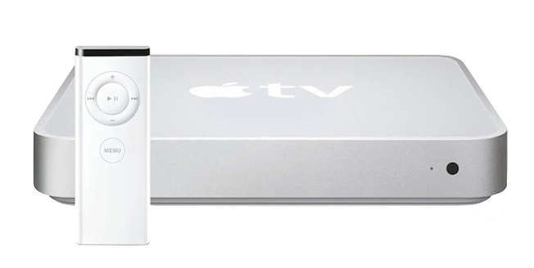
2007: iPhone 1st Gen
2006: iTV 1st Gen
Notes:
A little fun fact about Apple TV
Do you know, even though Apple TV only has 5 models
But It is actually older than the iPhone.
The first Apple TV was launch in 2006, and interestingly, at this time it still run on macOS

Slide 8
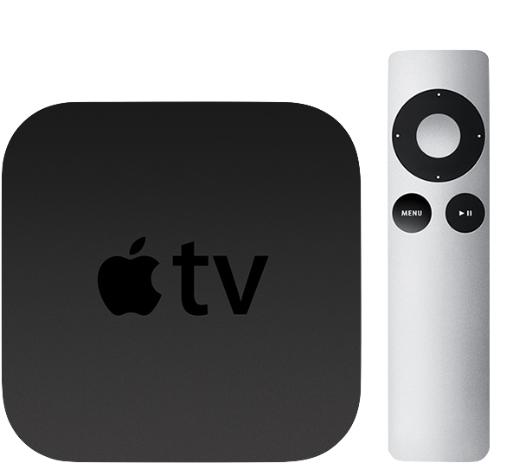
Apple TV 2nd Gen (2010)
Notes:
Until 2010, Apple redesign the Apple TV and make the second generation run on tvOS 9, which is 95% bases on iOS 9

Slide 9

Apple TV app
Notes:
You know, Originally I thought Apple TV is only applicable with Video and Gaming app.
In fact, there are many more kind of app on Apple TV further than that.
For example, Do u think you can book a hotel from a TV

Slide 10
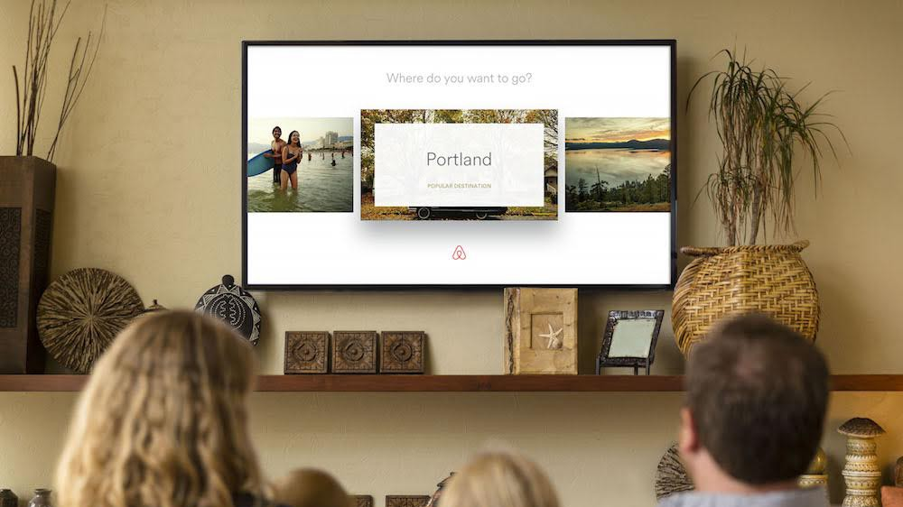
Notes:
The answer is, yes. Airbnb give you an option

Slide 11
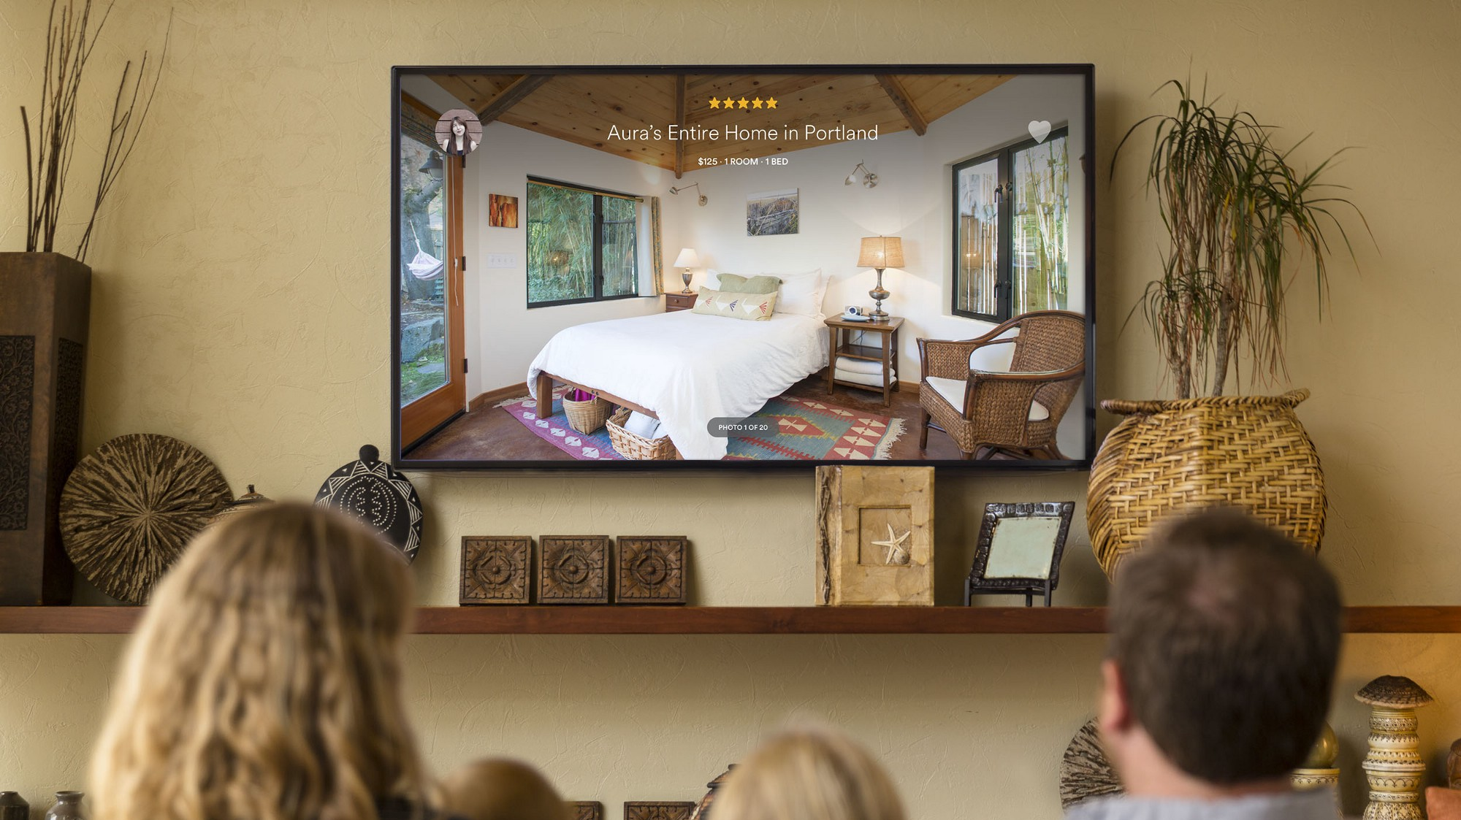
Notes:
Actually in some situations, Apple TV is a better solution than the iPhone,
Imaging we are planning for a vacation with our family.
Better if we can sit down and book the hotel together.
In this case, Apple TV is absolutely a better choice for the discussion because every one can see the hotel pictures on a shared TV.
On the other hand, the big picture is more attractive and make you more desire to book the hotel.
Compare with their rival which doesn’t have Apple TV app, they are losing this huge number of users

Slide 12
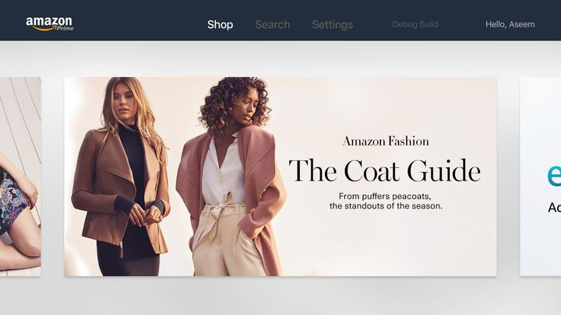
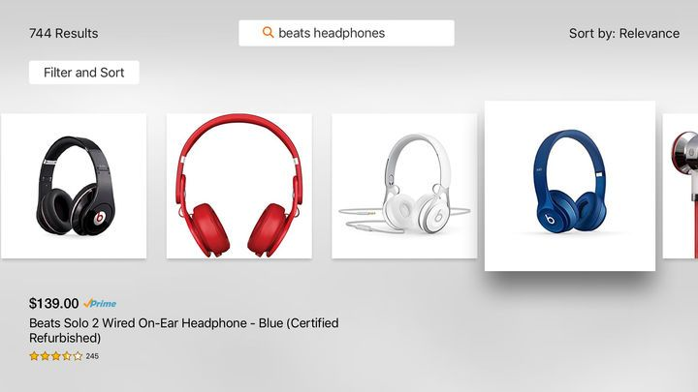

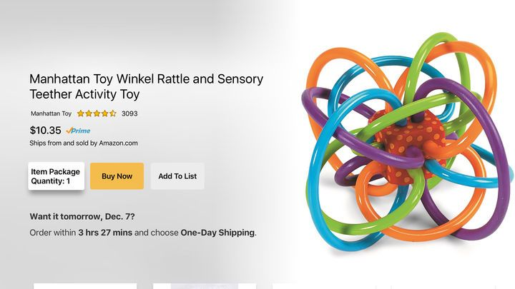
Notes:
Beside Airbnb, a lot of other services also support for Apple TV
For example, here I have Amazon, an e-commerce service. They allow you to shopping online through an Apple TV

Slide 13
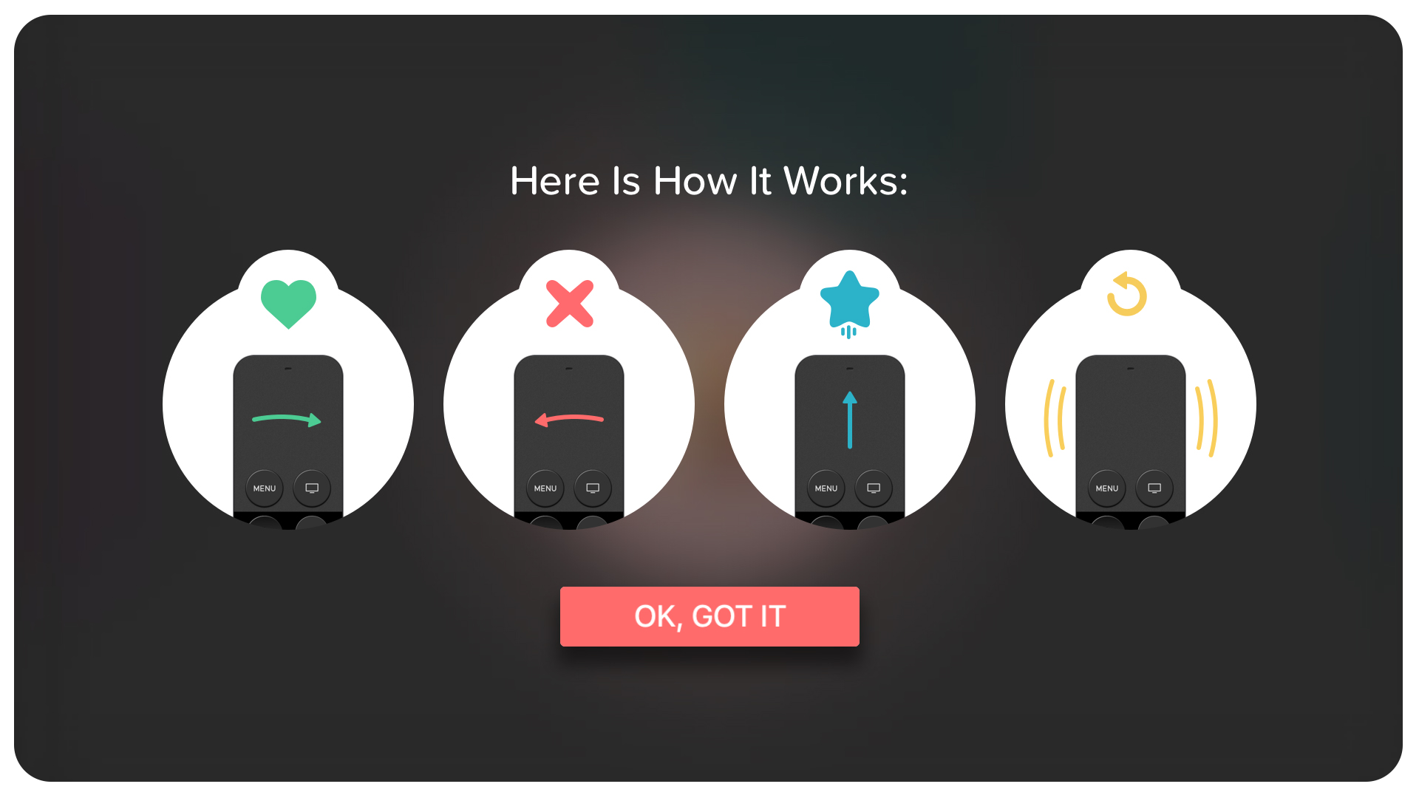
Notes:
Tinder, a social network application, is another example
As you can see, Apple TV apps are very diverse, and not only for video or gaming app
Therefore you can definitely have your own one.
In my perspective creativity has no limit. As long as you intend to have an Apple TV app, you would find a way to implement it

Slide 14
Apple TV sold
Notes:
Here I have a chart for Apple TV turnover from 2012 to 2017. Apparently, Apple TV is growing up very fast.
Actually 75 millions is a huge number because Apple TV is not an individual device.
Usually we only have one per family.
And you know right now with 75 million, Apple TV is the second largest TV Box brand in the world.
It’s impressive right?
Just keep in mind that, users who willingly spend money to buy an Apple TV for entertainment
They are very potential to pay for your service.
If you wanna expand your market, It’s obviously a good solution for you

Slide 15
Developing for Apple TV
Notes:
I will continue with some fundamental things when working with Apple TV

Slide 16
tvOS app
Custom app
Using same frameworks with native iOS
Client – Server app
Using TVML, TVJS, TVMLKit
Notes:
Apple provides 2 types of Apple TV app. In general, we will make them in different way.
First is the custom app which you develop it similarly when you do on iOS.
It use the same frameworks and concept that you already know about Storyboards, UIKit, Auto Layout.
The other one is client-server app, which you need to use TVML, TVJS and TVMLKit to make it.
I will explain to you these 3 abbreviation

Slide 17
TVML
TVJS
TVMLKit
Notes:
TVML (Television Markup Language) is a form of XML
In a Few slides later I will show you some example of a TVML template
TVJS (Television JavaScript) is a set of JavaScript APIs which provide the means to display apps created by TVML
TVMLKit is a framework which will help you be able to communicate between native tvOS code and TVML, Javascript code.

Slide 18
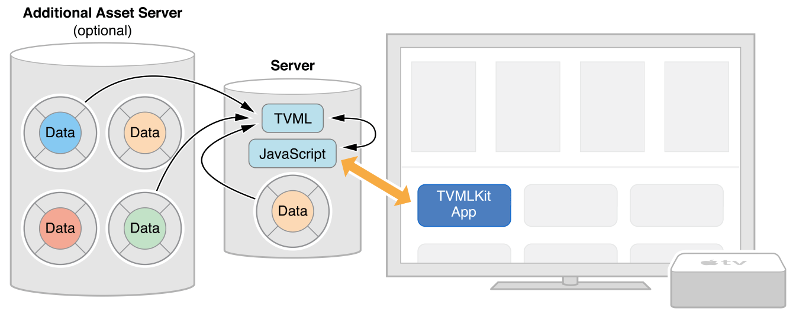
How Does TVMLKit App Work?
Notes:
Different with custom app, TVMLKit app is based on Client – Server architecture
Where your client app is a UIKit – based app running on a tvOS device
And your server hosts the media content and JavaScript files.
When app launch, it will download the main JavaScript file
And set up a JavaScript environment and hand over the control to JavaScript.
Once the control is handed over, JavaScript is responsible for downloading any additional content
that it needs to present the templates to the user.

Slide 19
TVML Premade Templates
Notes:
To make you easier to create a TVML App, Apple provide dozens of TVML premade template
Which you can use to display information in a specific way
So first I will start with a simple example

Slide 20
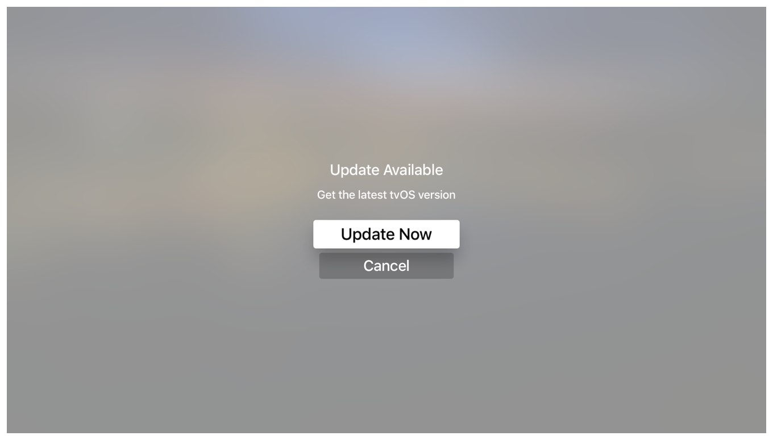
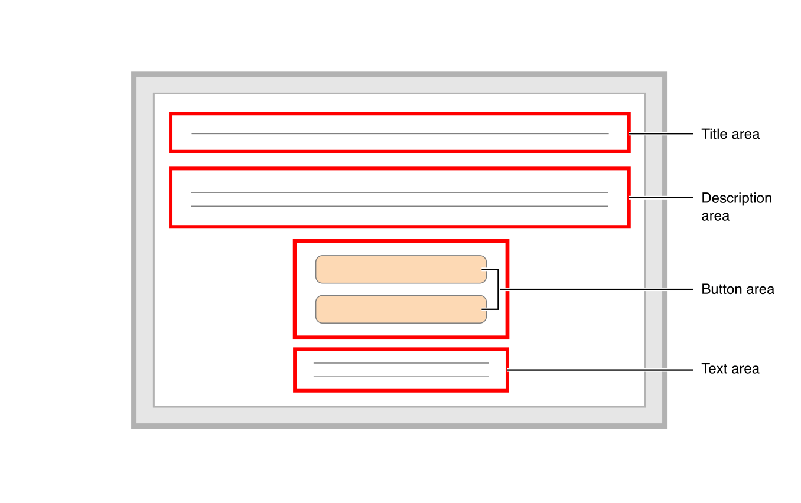
TVML Template Example
Notes:
On the screen I have an alert view on Apple TV
Beside it is a TVML template diagram
It’s not so hard to link each element from the diagram to the corresponding one on the view

Slide 21
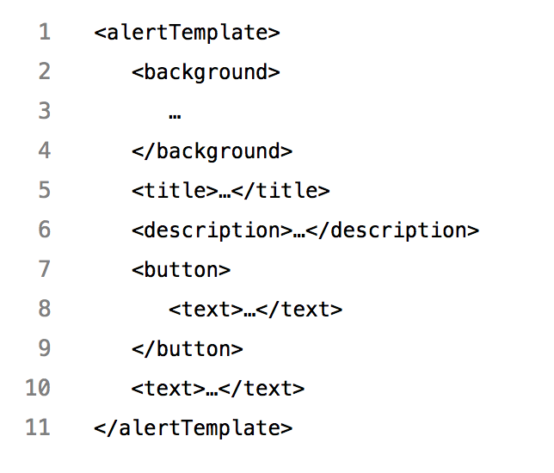
TVML Template Example
Notes:
And here is how the template code look like
If you know any markup language such as XML, HTML, you would be familiar to this format
Each field of the template is mapping 1 on 1 to an element on the diagram

Slide 22
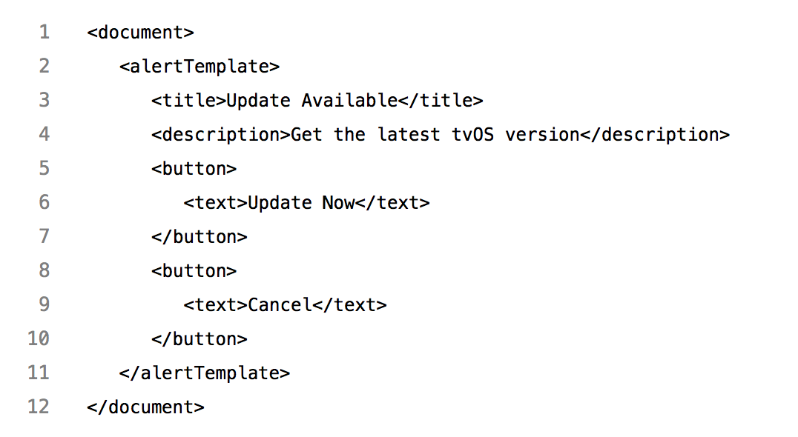
TVML Template Example
Notes:
And finally after filling with data,
TVMLKit will help you convert the template code to a native view as expectation
And let me assure you this is not a web browser, but completely native
Yay, so we just recently done with a very simple one.

Slide 23
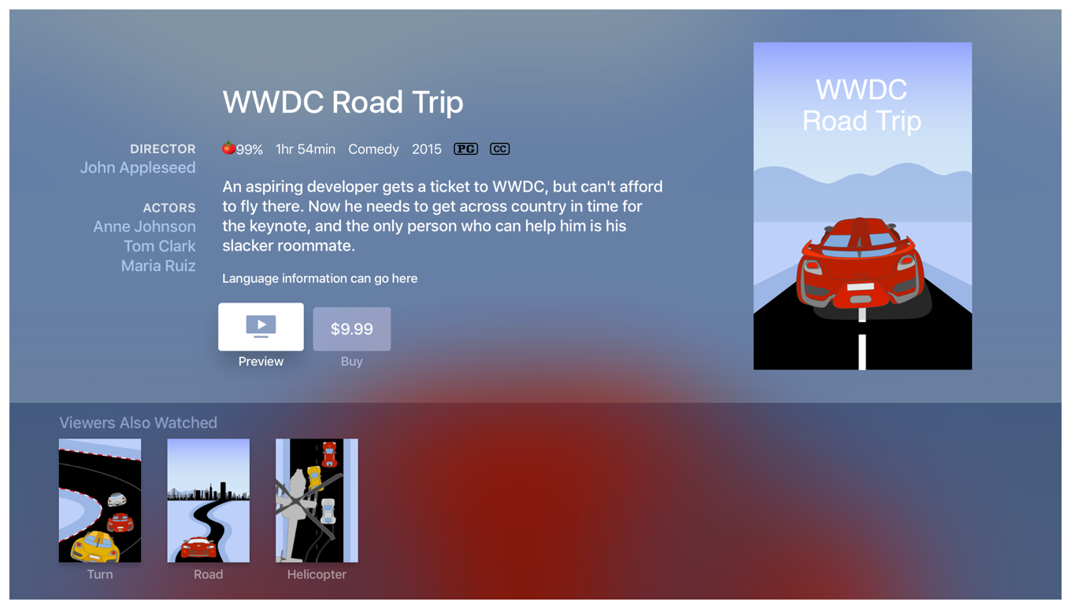
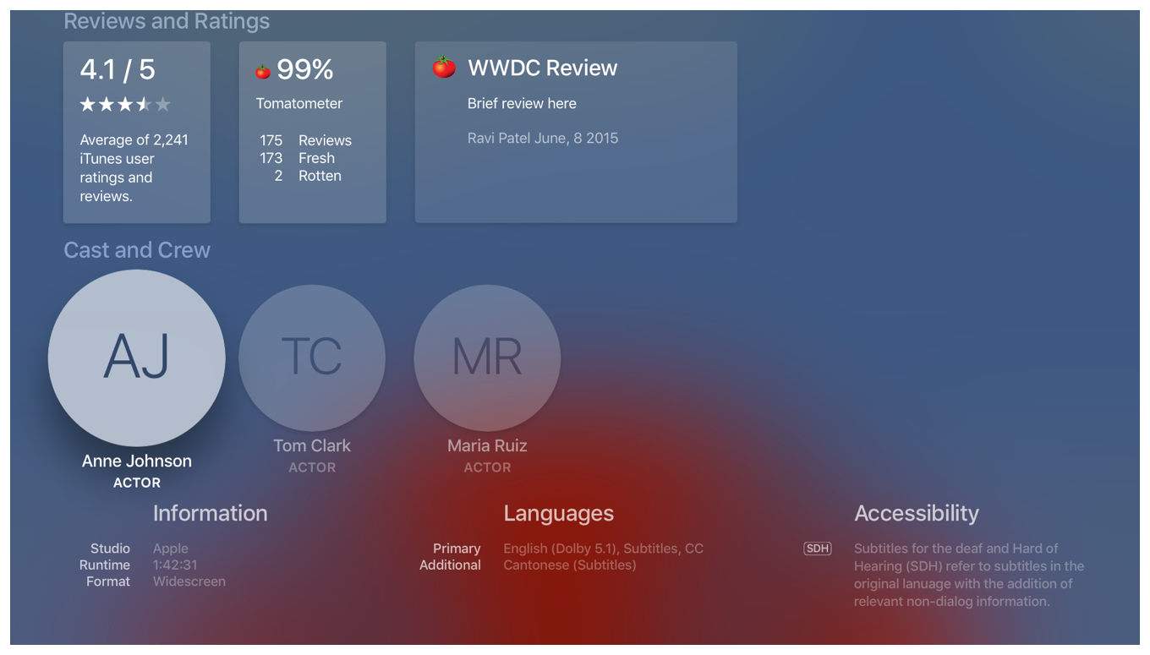
TVML Complicated Template
Notes:
And here I have another sample for a more complex layout.
Event though it is long, and complicated, but Apple also give you a template for it

Slide 24
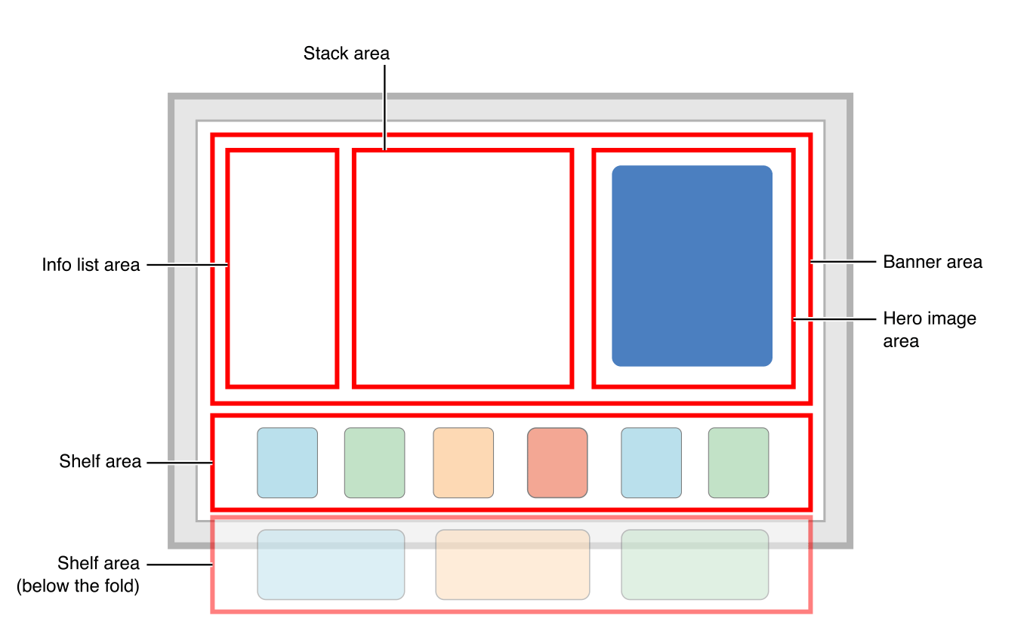
Notes:
And this is how the template diagram look like.
Very clear, specific and easy to understand
Again, you would not need to much effort to translate items from diagram to the view.

Slide 25
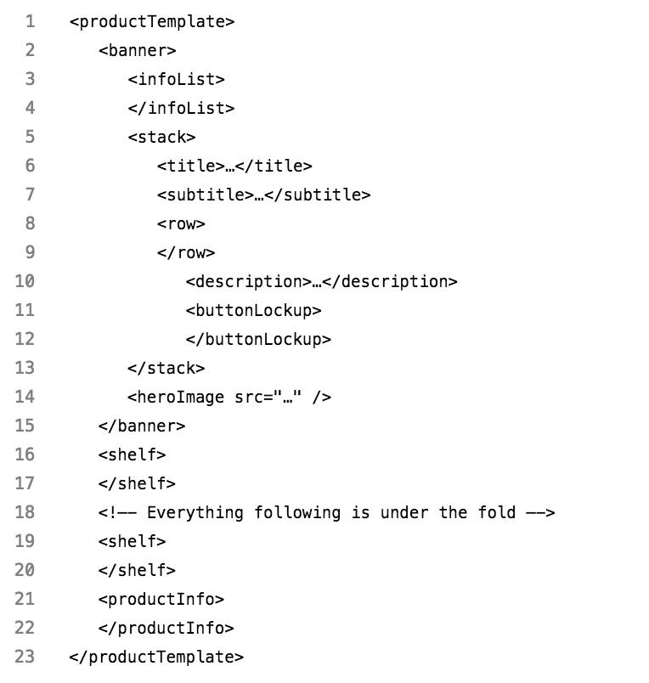
TVML Complicated Template
Notes:
After all. I have the template code.
You can just base on it to key in the data you wanna display. TVMLKit will take care the rest for you

Slide 26
COMPARISON
Custom App | TVML App
Same way with iOS native app | TVML, TVJS, TVMLKit
Swift, Objective-C | JavaScript
More effort but scalable | Less effort but not scalable
Suitable with customizing layout | Suitable with Apple template layout
Notes:
So I make a comparison between working on custom app versus on TVML app
We develop custom app by the same way we do on iOS, using Swift, Objective C
Whereas on TVML app we need use TVML, TVJS and TVMLKit with JavaScript
The custom app will take you more effort for creating, but it is scalable in long term and this if your app has customizing design, it could be your choice.
On the other hand creating TVML app cost you less effort at the beginning, but it is not scalable and only appropriate with the app has similar design with Apple template layout
So depends on your purpose you can find a most suitable way to build your tvOS app.
But for us here in Viki, we have implemented our Apple TV app in both ways. With our experience, I would recommend you to make a custom app instead. Because
First we already have an iOS project which has a lot of similar feature with Apple TV app
By using custom app we can reuse a lot of code, and it make us can maintain and scale both app together
Secondly, it will take you a lot of time to ramp up with TVML because it’s a new concept.
And for those who hasn’t work with JavaScript before, it will be more time consuming to get used to it.

Slide 27

vs
Notes:
In my opinion, Honestly, I am much more comfortable to work on Swift than on JavaScript.
Because I got used to Swift and Objective C when working on iOS.
Also, on Swift and ObjC you can easily use break point within Xcode, it is very useful for us when debugging.
But on JavaScript it’s hard to use it.
You need more effort to set it up.
And also, one line in JavaScript may very long and may make us harder for observing the break point.

Slide 28
Developing Custom Apple TV App On iOS Project
Notes:
Therefore I will continue with developing custom app on an iOS project
Our object is to build an Apple TV app with the least cost.
Assuming we already have an iOS native project, so let’s see what we can take advantage for tvOS

Slide 29
Project structure
UI
View, ViewController
Very little, Only for base classes
Business Logic
API Service, Deep Link Handler, Analytics, etc
All logic code for both platform should be shared
Third Party Libraries
Install from CocoaPods, Carthage or import Framework directly
Most of the 3rd Party Libraries on iOS are available on tvOS
Core Framework
Foundation, UIKit, CoreData, etc
Most of the core frameworks on iOS are available on tvOS
Notes:
Basically, we always be able to split our iOS project into 4 different layers
At the bottom is some core framework and 3rd party libraries. We use them as the ingredient to make our app
Then we have Business Logic Layer, generally for NonUI code.
Here it will offer some services like API Service, or Payment Service, or Deeplink Handler, …
And the top one is UI Layer, particularly for UI code
Let’s see with this structure, what can be reusable on tvOS
Because tvOS is very close to iOS. Therefore most of the frameworks, and 3rd libraries on iOS are also available on tvOS
For instance RxSwift, React Native, Alamofire, SwiftyJSON, and many other libraries we are using on iOS, they all support for tvOS
Ideally all logic code use in both platform must be shared together. It makes us be able to maintain and scale the business.
We will not reuse much UI Code because layout for iOS devices are very different to for Apple TV
We may only share some UI Class extension, like UILabel or UIButton extension
I really encourage you to isolate UI and Logic code. It also will make our iOS project more organized and testable.
So I have talk about theory too much. Let’s start with a Demo. I will show you in reality.

Slide 30
Demo

Slide 31
CONCLUSION
Potential Market
Applicable For Any
Kind Of Business
Low cost
High impact
Notes:
Finally, I have 3 points want to summarize to you
First, Apple TV is a very potential market, it’s keep increasing 100-150% year over year
Secondly, Apple TV is adaptable with any kinds of business, not only for video or gaming
And finally, building and maintaining Apple TV app doesn’t cost you too much, especially if you already have an iOS project
In fact, by making custom Apple TV app, it offers you a chance to clean up iOS project, make it more organised, more structured, more testable
And that’s all i wanna share with you today

Slide 33
Thanks for your attention

